Slide 1

Multiple Regression ANALYSIS & Classification on ABC Company Employees’ Salaries
Notes:
Hello everyone , My name is Tamrat :
Today , I would like to present a mini project on Multiple regression analysis and classification on ABC Employees Salaries. I hope you will find it useful.

Slide 2
Overview of the dataset
Project’s Objectives:
Dataset Exploration
methodology of study
Result and Interpretation
Summary and Conclusion
Topic of discussion:
Notes:
Based on this multiple regression analysis project : The following topic will be discussed : First I would provide you a brief description on the dataset. Then I will discuss the objectives of the project , methodology used , result and interpretation and finally a summary of the project will be presented.

Slide 3
The ABC Company has 500 employees. The dataset of the company originally contains 500 rows and 13 columns. After data wrangling, it is reduced to 500 rows and 6 columns
Variable Description :
Emp_ID : Employee _ID
Emp_Age : Age of employees
Experience: Work experience of the employees
Sex : Male or Female Employee
Education in Year: Educational Qualification (Diploma/Degree / Masters )
Annual_Rate : Annual salary of employee
Notes:
The ABC Company has 500 employees. The dataset of the company originally contains 500 rows and 13 columns. After refining the relevant variables , it has now reduced to 6 columns as you can see here.

Slide 4
This project emphasizes the use of regression analysis and classification to examine a relationship between multiple features and a target variables.
The Project Objectives
Notes:
This project emphasizes the use of regression analysis and classification models to examine the relationship between multiple features and a target variables mentioned in the previous slide.

Slide 5
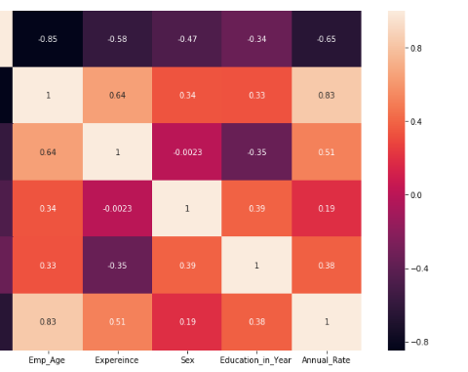
Dataset Exploration
Fig 1: Heatmap : The heatmap shows the plosive correlation as we go up to lighter color
The ABC Company’s Dataset Heatmap:
Notes:
Data exploration is the initial step in data analysis in which we use data visualization and statistical techniques to describe dataset characterizations, such as size, quantity, and accuracy, in order to better understand the nature of the data. Based on this, the lighter color on The ABC company dataset heatmap show the positive correlation between the features and the target variable.

Slide 6
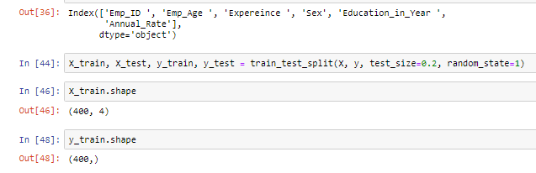
Methodology of study
Train-Test Split Technique
Notes:
to better evaluate the performance of the linear regression model, Train-Test Split technique was used to split the dataset. The dataset was then split to have 80% trainset and 20 % test set to contains X and Y each to contain 400 train data and X and Y each to contain 100 rows test data.

Slide 7
Model:
Notes:
Multiple regression analysis is a form of predicting modeling technique which investigates the relationship between dependent and multiple independent variables. based on the project objectives , Regression model was applied to examine a relationship between multiple features and a target variables.

Slide 8
From the regression equation, We know that :
,
Notes:
The model has the following formula. Where Y is the predicted /targeted value; X₁ through X_{p} are p distinct Predictor variables,b₀ is the Y intercept and b₁ through b_{p} are the estimated regression coefficients. Based on this equation , the model help us to understand the strength of the predictor, forecast an effect and point estimate.

Slide 9

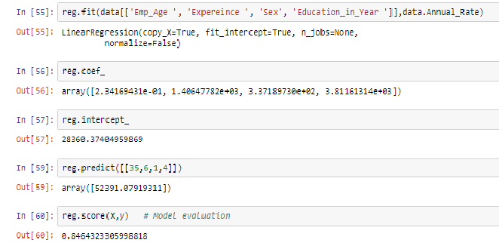
Notes:
Based on the given equation: ABC company employees dataset with 500 rows and six columns were Analyzed: hence , A trained dataset was fitted in to the model to predict the regression model. As you can see below the model show 0.84 accuracy .

Slide 10
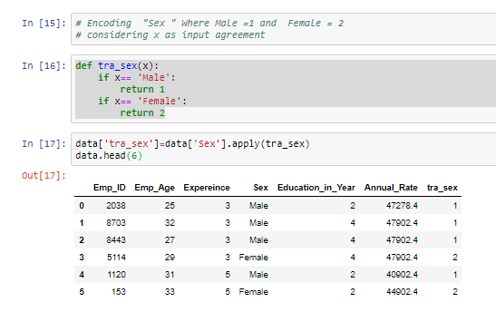
Classification and Regression Analysis with “Sex” vs “Annual Salary”:
Label Encoding:
Notes:
The second scenario was to detects the accuracy of sex and annual salary relationship. Since machine learning algorithm can only read numerical values, there was a need to convert categorical values into numbers. Accordingly, the Sex feature was encoded as Male = 1 and Female= 2 as shown hereunder.

Slide 11
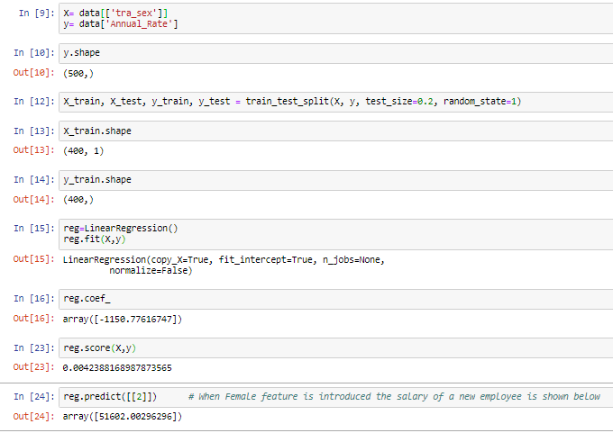
Notes:
After the encoding the sex variable, the dataset containing the sex (the feature) and annual salary (the target)were split into two subsets with 80% to 20 % training set and test set respectively to find out the accuracy of the regression model as shown on the slide. From this , the model show 0.0024 accuracy . From this we deduce that there is weak relationship between Sex and the target variable.

Slide 12
Results and Interpretations
The model, based on numerical values of age, work experience and education predictors. The accuracy of the model is found to be 0.85.
relationship between sex independent variable and annual salary the dependent variable and the accuracy of the model showed 0.0045.
Notes:
The goal of the project was to determine the ability of age, work experience and education to predict the annual income of employees at ABC company by using multiple regression machine learning algorithm. The model, based on numerical values of age, work experience and education predictors. The accuracy of the model is found to be 0.85. The study further implemented the regression analysis model to see relationship between sex independent variable and annual salary the dependent variable and the accuracy of the model showed 0.0045.
This means that the two variables have very weak relationship.

Slide 13
Next Steps:
Notes:
For this session This project was focused on multiple regression and classification models. In the next session I will present you other machine learning models . I hope you enjoyed the presentation. For your comment and question

